Slide 1
Employee Data Analysis using Excel
STUDENT NAME:
REGISTER NO: 312204239
DEPARTMENT:B.Com(Accounting and finance)
COLLEGE:Annai violet arts and science college
Keerthana.B

Slide 2

PROJECT TITLE
Using Pivot Tables For Employee Turnover Analysis

Slide 3


AGENDA
Problem Statement
Project Overview
End Users
Our Solution and Proposition
Dataset Description
Modelling Approach
Results and Discussion
Conclusion
3/21/2024 Annual Review

Slide 4

PROBLEM STATEMENT
Employee turnover is a critical metric for any organization. It refers to the rate at which employees leave the company and need to be replaced. A high turnover rate can be costly in terms of recruitment, training, and loss of productivity. Understanding the factors contributing to employee turnover can help HR teams create better retention strategies

Slide 5

PROJECT OVERVIEW
To perform a detailed analysis of employee turnover within an organization using pivot tables. The goal is to identify key factors driving turnover rates and generate actionable insights to improve employee retention, reduce turnover costs, and enhance overall organizational performance.

Slide 6

WHO ARE THE END USERS?
Human Resources (HR) Team
HR Managers and Business Partners
Departmental Managers and Team Leaders
Executives and Senior Leadership (C-Suite)
Finance Department
Recruitment and Talent Acquisition Teams
Employee Relations Specialists

Slide 7

OUR SOLUTION AND ITS VALUE PROPOSITION
Our solution leverages pivot tables in Excel or Google Sheets to perform a comprehensive analysis of employee turnover data. The pivot table functionality allows for dynamic filtering, grouping, and summarization of key metrics such as turnover rates, department-specific trends, reasons for leaving, and correlations with factors like tenure, performance, and demographics.

Slide 8
Dataset Description
This dataset forms the foundation for a robust employee turnover analysis using pivot tables, providing valuable insights to HR professionals and business leaders on trends, patterns, and strategies for improving retention.
To conduct a comprehensive analysis of employee turnover, a well-structured dataset is essential. Below is a detailed description of the typical fields (columns) that should be included in the dataset for analysis using pivot tables.

Slide 9

THE "WOW" IN OUR SOLUTION
Our solution brings a “wow” factor through its simplicity, power, and impact.
Instant Insights with Minimal Effort
Real-Time, Interactive Data Exploration
Customized Dashboards and Visualizations
Actionable, Data-Driven Decisions
Cost-Saving Efficiency
3/21/2024 Annual Review
9

Slide 10
MODELLING
When using pivot tables for employee turnover analysis, the “modeling” involves structuring the data and building specific analysis views to uncover trends, patterns, and actionable insights. The pivot table helps model relationships between employee attributes (e.g., tenure, department, job role, performance) and turnover outcomes. Below is an outline of how to approach modeling employee turnover using pivot tables
10

Slide 11
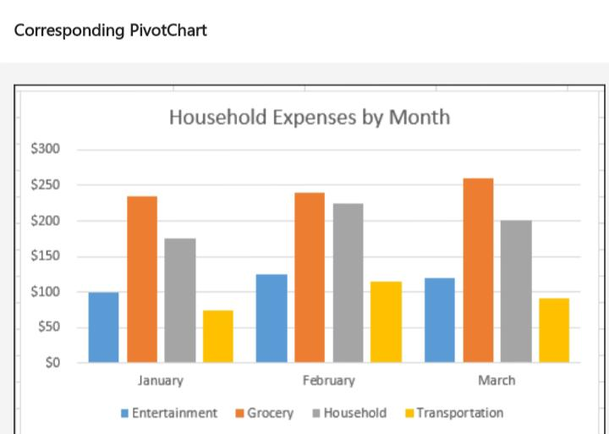
RESULTS
11

Slide 12
conclusion
The Employee Turnover Analysis using pivot tables provides powerful insights into the dynamics of employee departures across various dimensions such as department, tenure, job role, performance, and demographics. Pivot tables are an effective and flexible tool for HR teams to explore and visualize complex turnover data, identify key trends, and uncover root causes of employee attrition.
In conclusion, using pivot tables for turnover analysis is a simple yet highly effective method for HR professionals to transform raw employee data into valuable business insights.

